Slide 1

Disability Rises Gradually in an Elderly Cohort
Lois M. Verbrugge
Dustin C. Brown
University of Michigan

Slide 2
Purpose
For a cohort of elderly people:
What happens to disability over time as members acquire functional problems, and some die?
Do cohort disability levels rise sharply or gradually, or do they stay steady, or even decline over time?
We describe changes in ADL, IADL, and PLIM disability over time for a single cohort of U.S. adults ages 70 and older.

Slide 3
Background
  We examine disability changes for cohort members in three groups:
  Living cohort: Cohort members alive at each interview wave
  Decedent groups: Cohort members who die between one interview wave and the next
  Survivor groups: Cohort members who manage to live up to a given interview wave
Only one other analysis used similar approach to describe cohort disability changes over time (Christensen, McGue, Petersen, Jeune, Vaupel, 2008).

Slide 4
Hypotheses
H1: Disability rises over time for the living cohort.
H2: Disability rises over time for all decedent groups, but less rapidly for later decedents than earlier ones.
H3: Earlier decedent groups have more baseline disability than later decedent groups at every wave.
H4: Disability rises over time for all survivor groups, but less rapidly for later (longer) survivors than earlier (shorter) ones.
H5: Earlier (shorter) survivor groups have more baseline disability than later (longer) survivor groups at every wave.
H6: Women have higher disability levels than men, but both groups have similar disability changes over time as the total cohort.
H7: The older elderly have higher disability levels than the younger elderly, but both groups have similar disability changes over time as the total cohort.

Slide 5
Data and Measures
Data
Study of Asset and Health Dynamics Among the Oldest-Old (AHEAD)
Interview Waves: 1993, 1995, 1998, 2000, 2002, 2004, 2006, 2008, 2010
Age-eligible AHEAD respondents in 1993 (ages 70+; N = 7,227)
At last wave, living cohort members are ages 87+ (N = 1,065)
Disability Measures
Personal care (ADL, range 0-5)
Household management (IADL, range 0-5)
Physical limitations (PLIM, range 0-9)
Strata
Gender
Baseline age (70-79, 80+)

Slide 6
Methods
Plot mean disability levels for the living cohort, decedent groups, and survivor groups over time
Descriptive analyses – no age adjustment, controls, or multivariate models.
Time and age are effectively the same.
The cohort's aging process is captured in changes over calendar time.
Analyses are performed for the total sample and repeated for men, women, baseline ages 70-79, and baseline ages 80+
Community-dwelling and nursing home respondents
Non-zero weights are created for nursing home residents

Slide 7
Goal
Describe how the aging process unfolds over time for a cohort

Slide 8
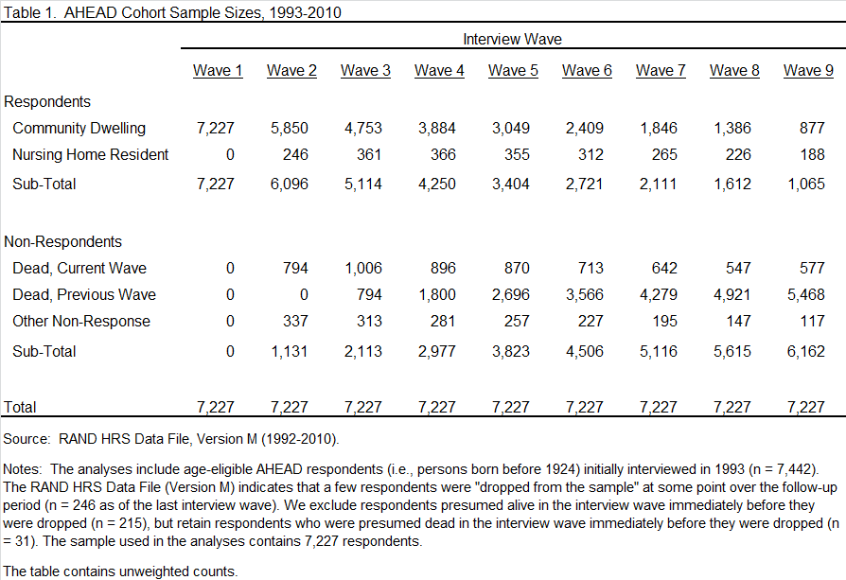

Slide 9
Living Cohort

Slide 10
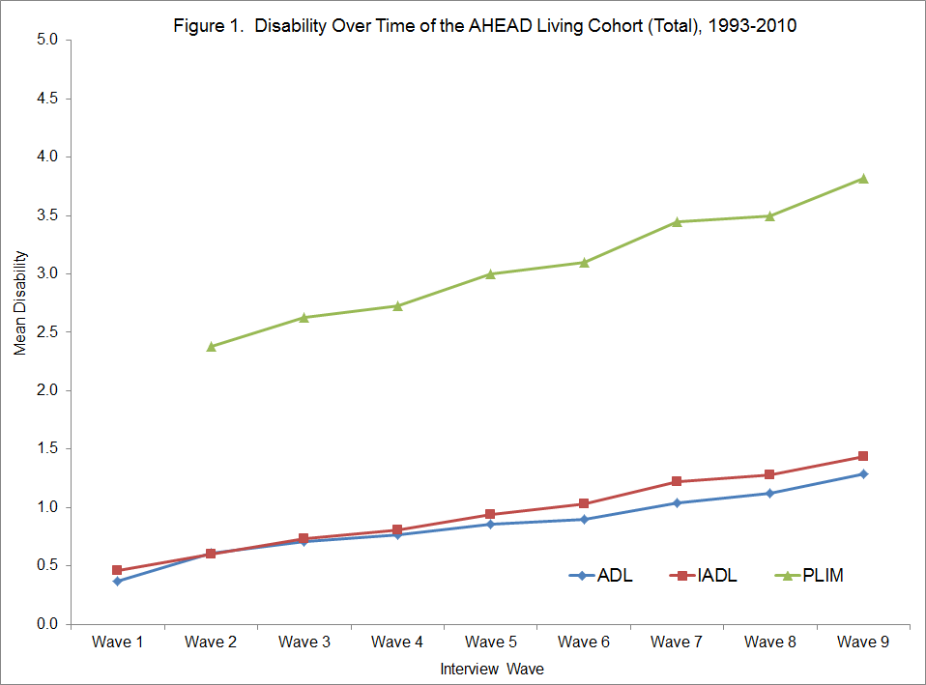

Slide 11
Decedent Groups

Slide 12
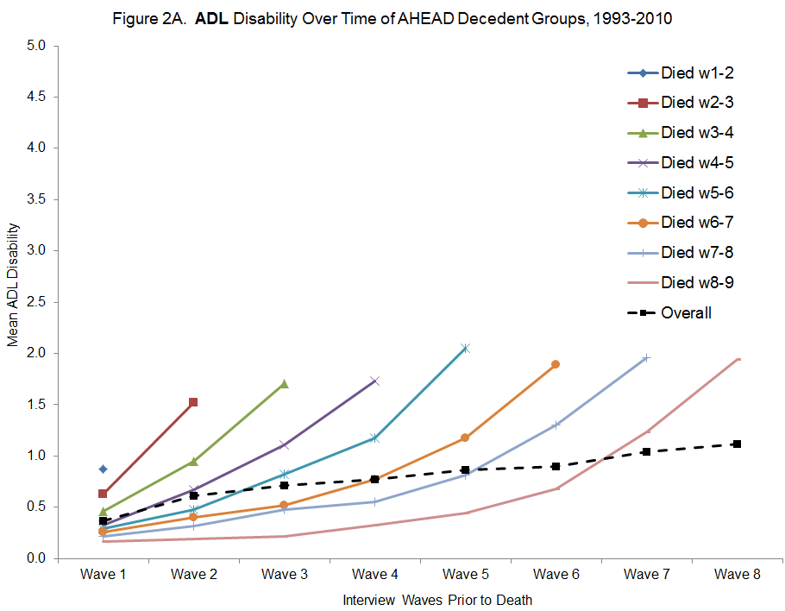

Slide 13
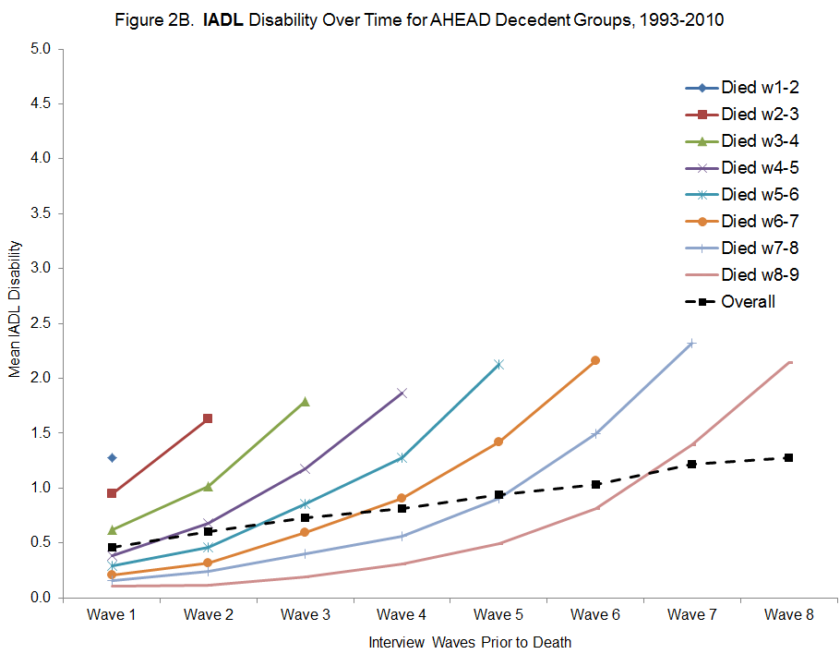

Slide 14
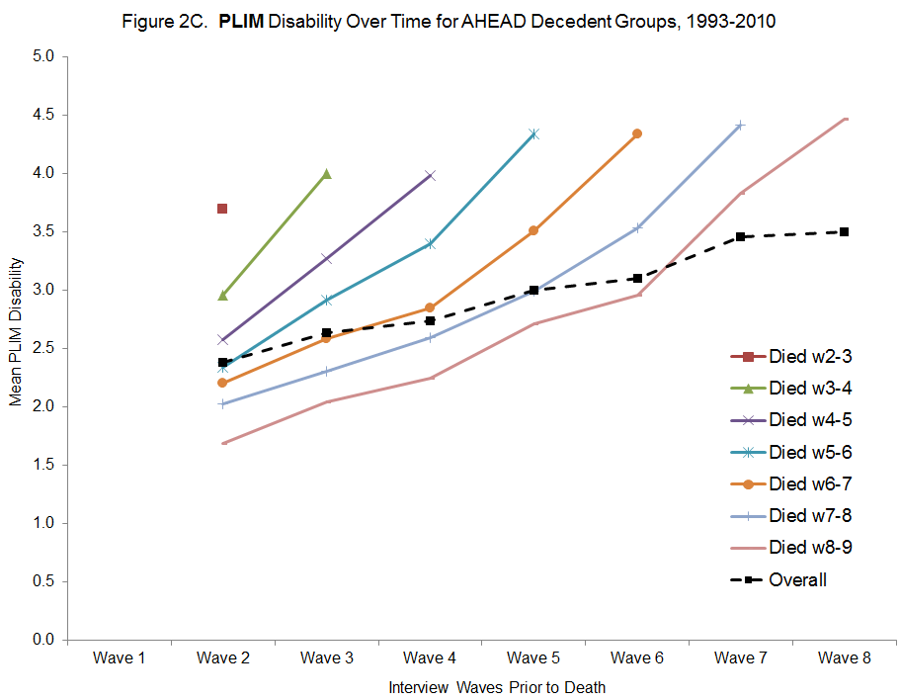

Slide 15
Survivor Groups

Slide 16
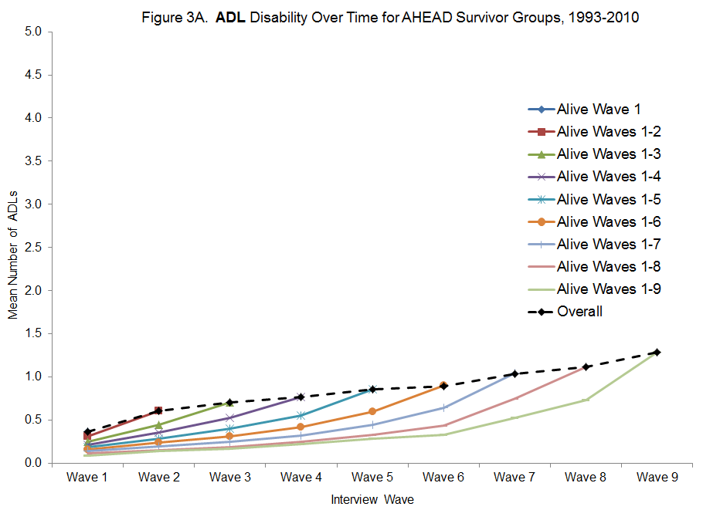

Slide 17
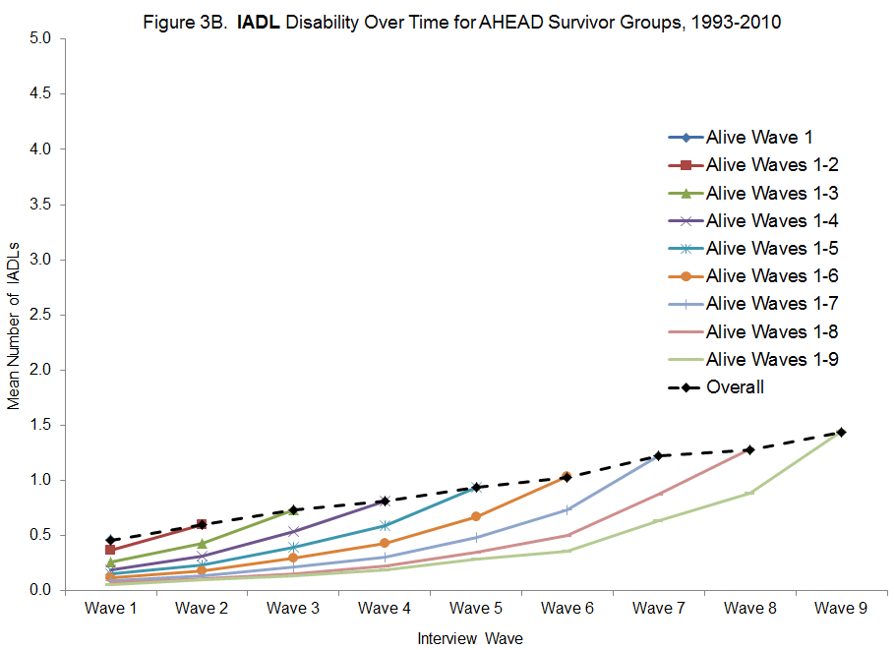

Slide 18
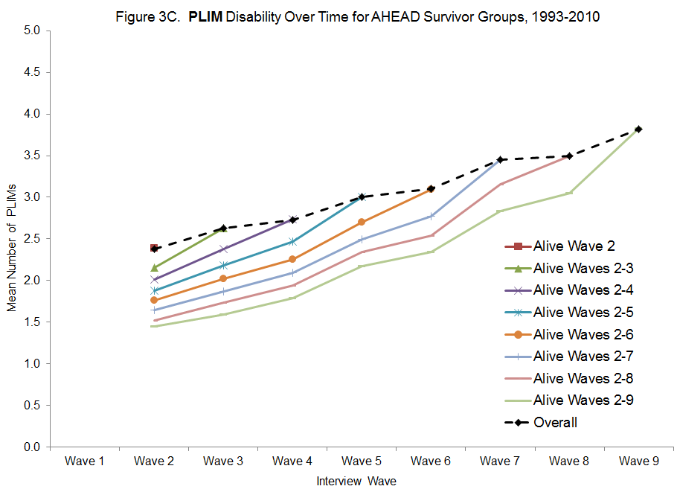

Slide 19
Key Results
Disability rises gradually for the living cohort over time.
Decedent groups have much higher disability than the living cohort.
Earlier decedent groups have higher disability than later ones, but disability rises sharply for everyone near death.
  Longer survivor groups have less disability, and slower disability increases, than shorter survivor groups.
  Women have higher disability levels than men at all time points, but disability patterns over time are the same for women and men.
  Disability patterns for younger (70-79) and older elderly (80+) groups are similar to those for the total cohort.

Slide 20
Comparison
  Despite differences in sample sizes, ages, and observation lengths, results in the US and Danish studies are similar:
Small rises in disability for the living cohort over time.
Larger rises in disability among survivor groups and decedent/stop groups than the living cohort.
Monotonic differences across groups at every wave, with higher disability among shorter survivor groups and earlier decedent/stop groups.
Sharper rises in disability over time for shorter survivor groups (cf. longer ones) and earlier decedent/stop groups (cf. later ones).

Slide 21
Conclusions
  Commonplace assumption that disability rises sharply with age in populations is not true from a cohort perspective.
  Disability levels increase only gradually as the cohort ages, even when cohort members are in their 80's and 90's.
  The continuity in results across gender and age strata implies that the observed disability changes are general and will exist in other cohorts.
  There is some intrinsic fitness (biological, behavioral, psychological) among longevous people.
  Efforts to slow disablement in late life will not result in a very ill and frail population, but instead in one with just moderate levels of disability.

Slide 22
Ancillary Tables & Figures

Slide 24
Results: Gender

Slide 25
Living Cohort

Slide 26
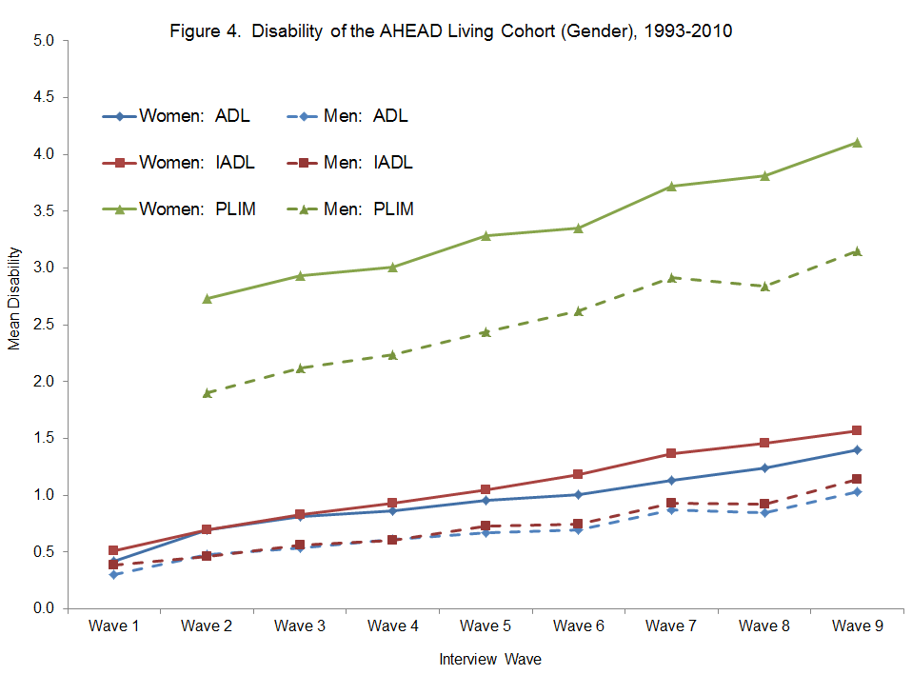

Slide 27
Decedent Groups

Slide 28
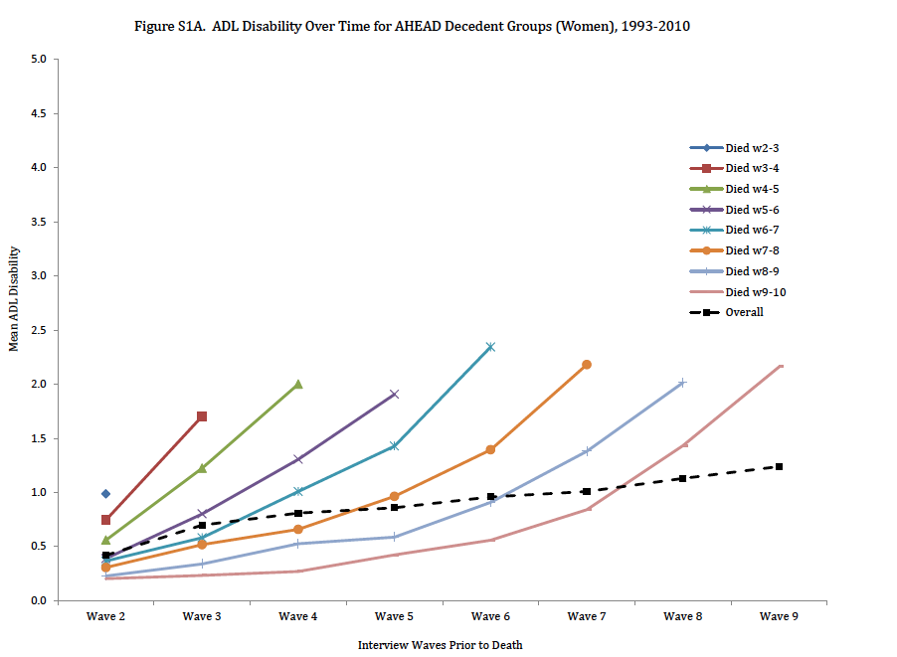

Slide 29
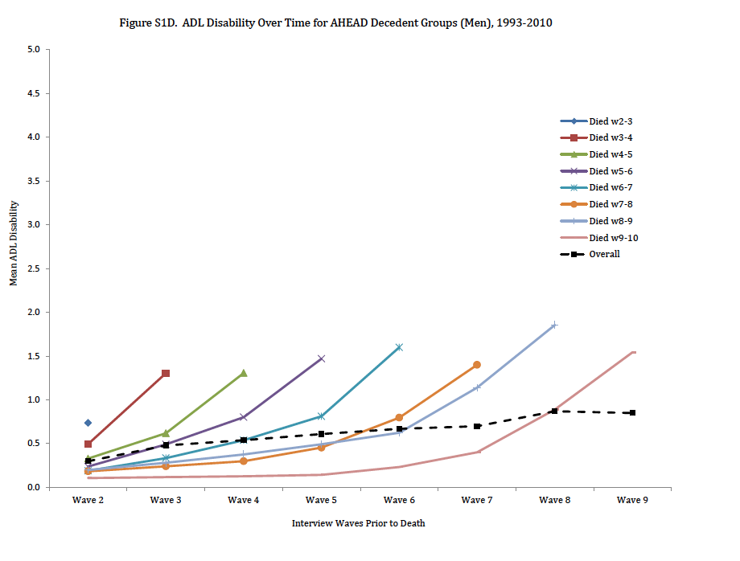

Slide 30
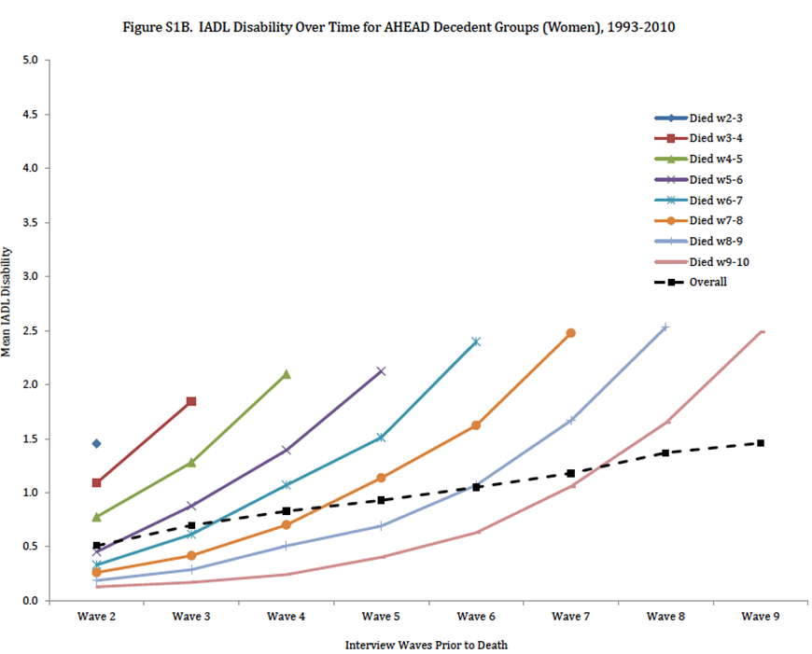

Slide 31
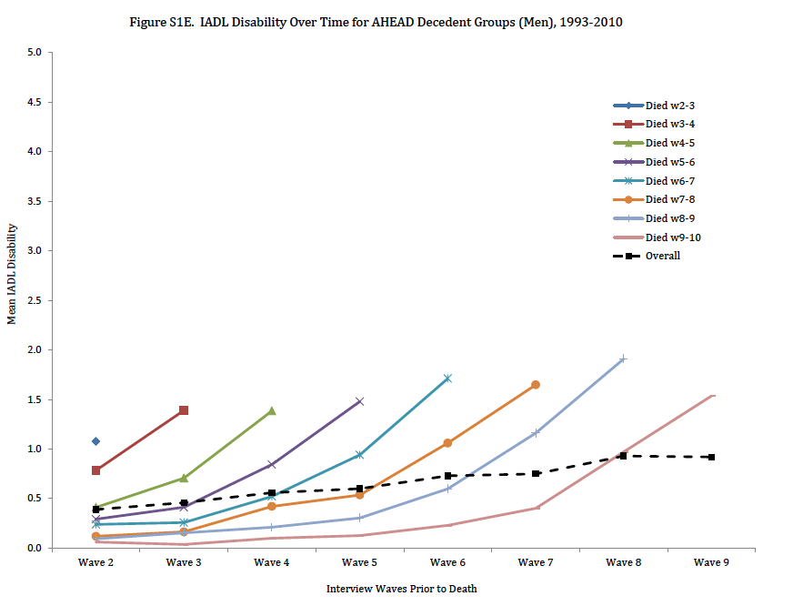

Slide 32
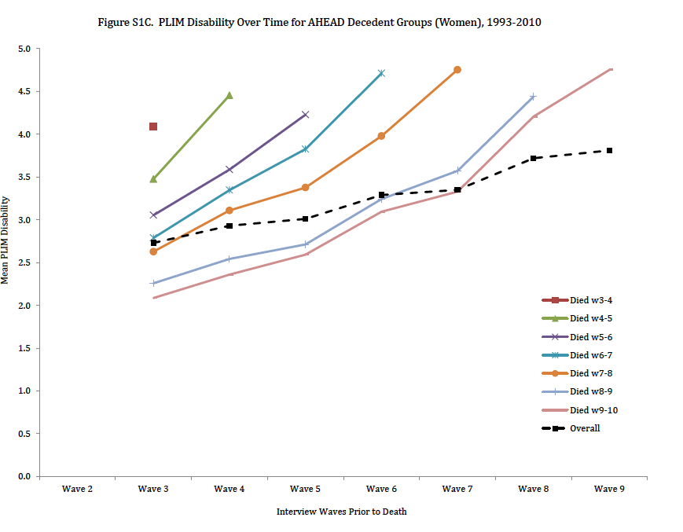

Slide 33
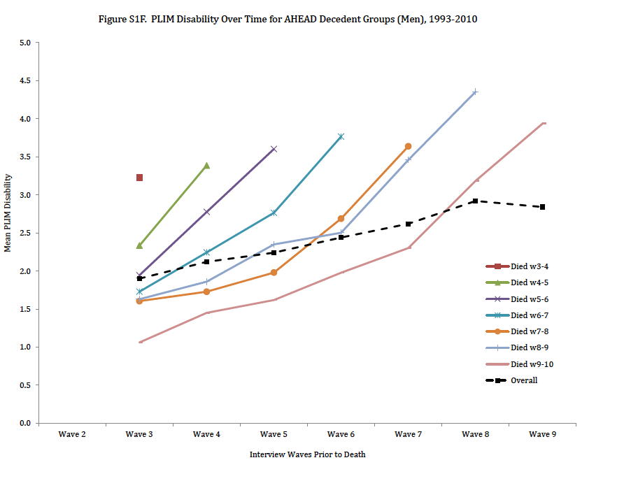

Slide 34
Survivor Groups

Slide 35
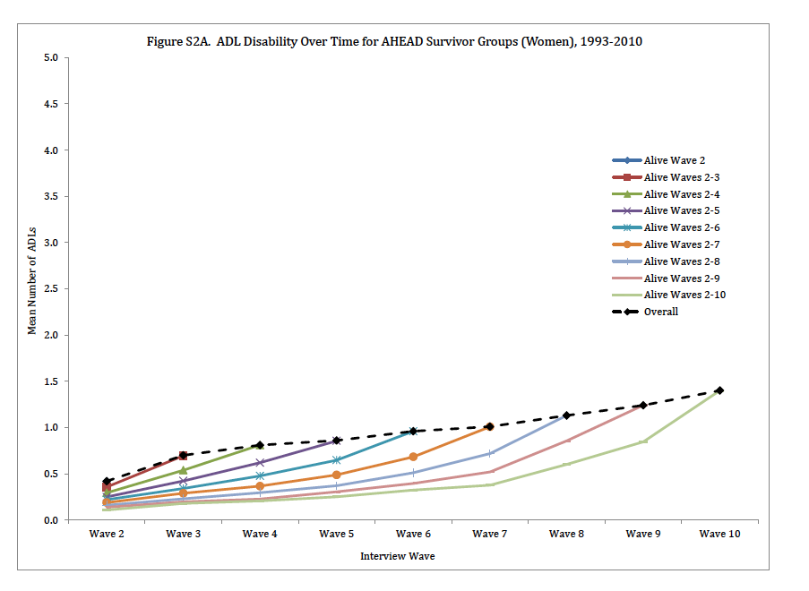

Slide 36
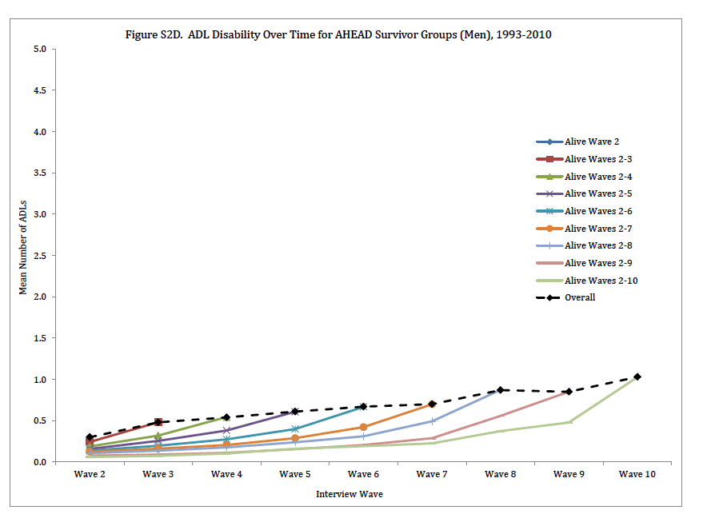

Slide 37
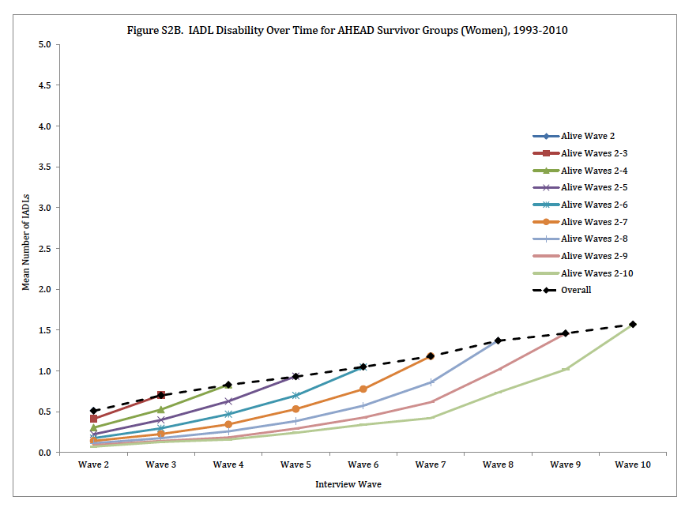

Slide 38
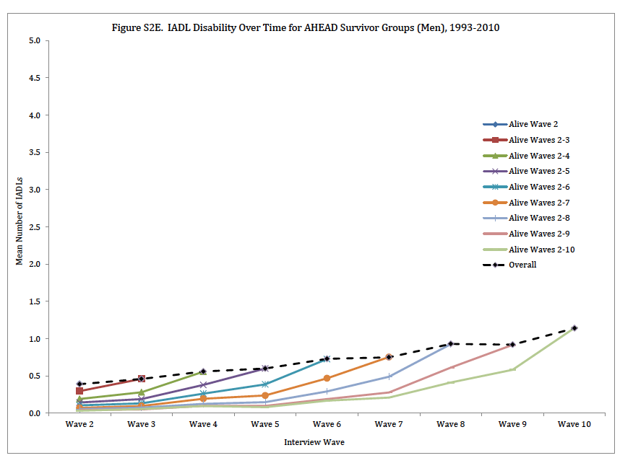

Slide 39
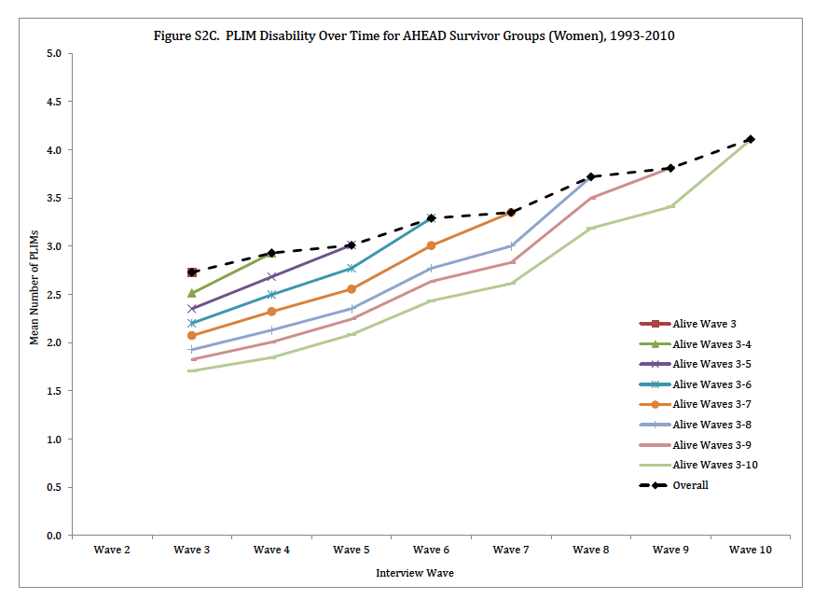

Slide 40
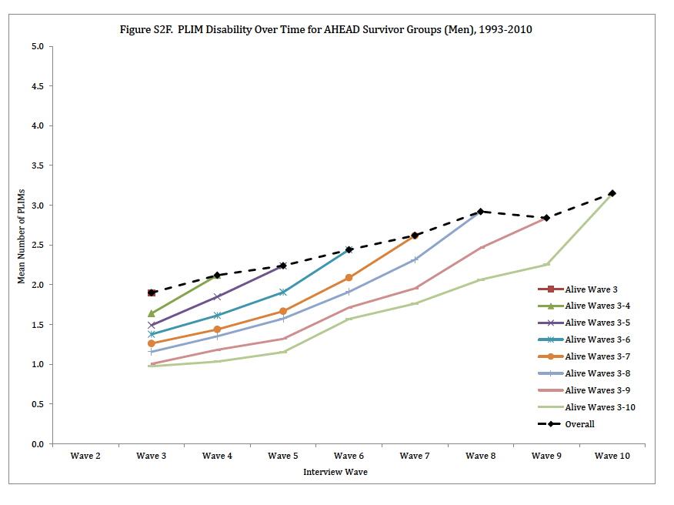

Slide 41
Results: Baseline Age

Slide 42
Living Cohort

Slide 43
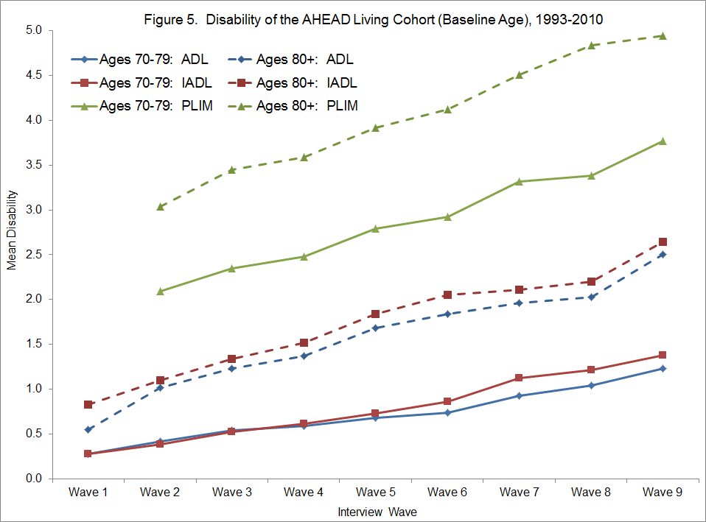

Slide 44
Decedent Groups

Slide 45
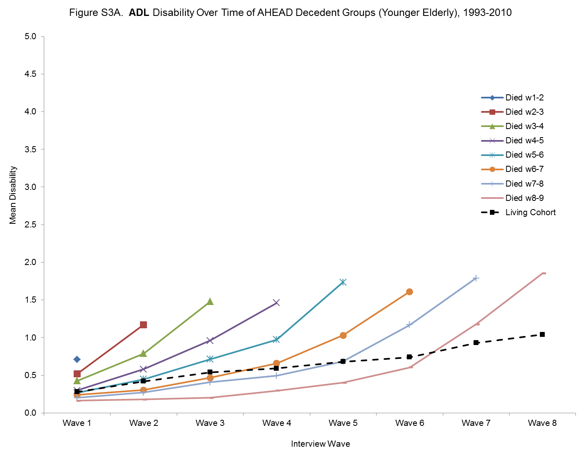

Slide 46
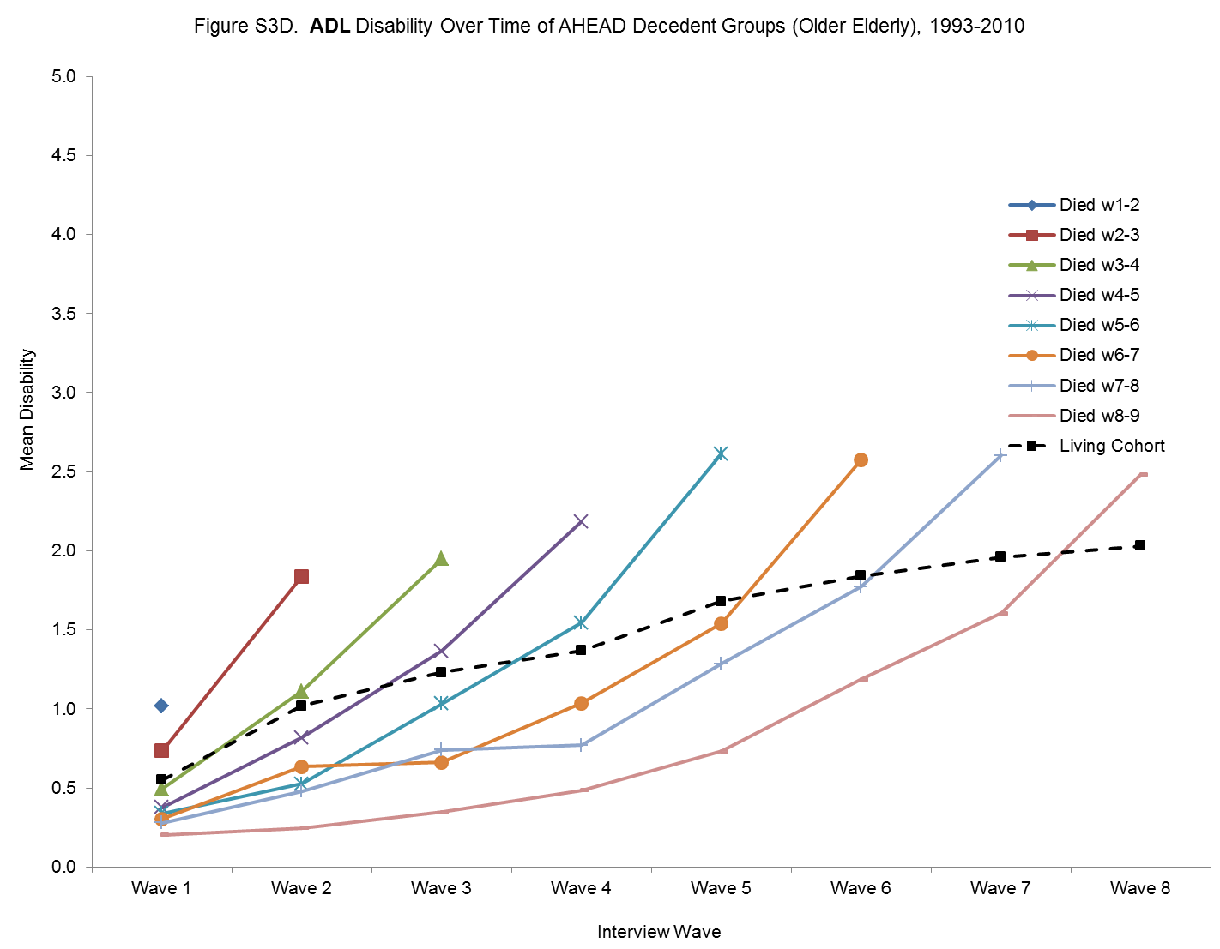

Slide 47
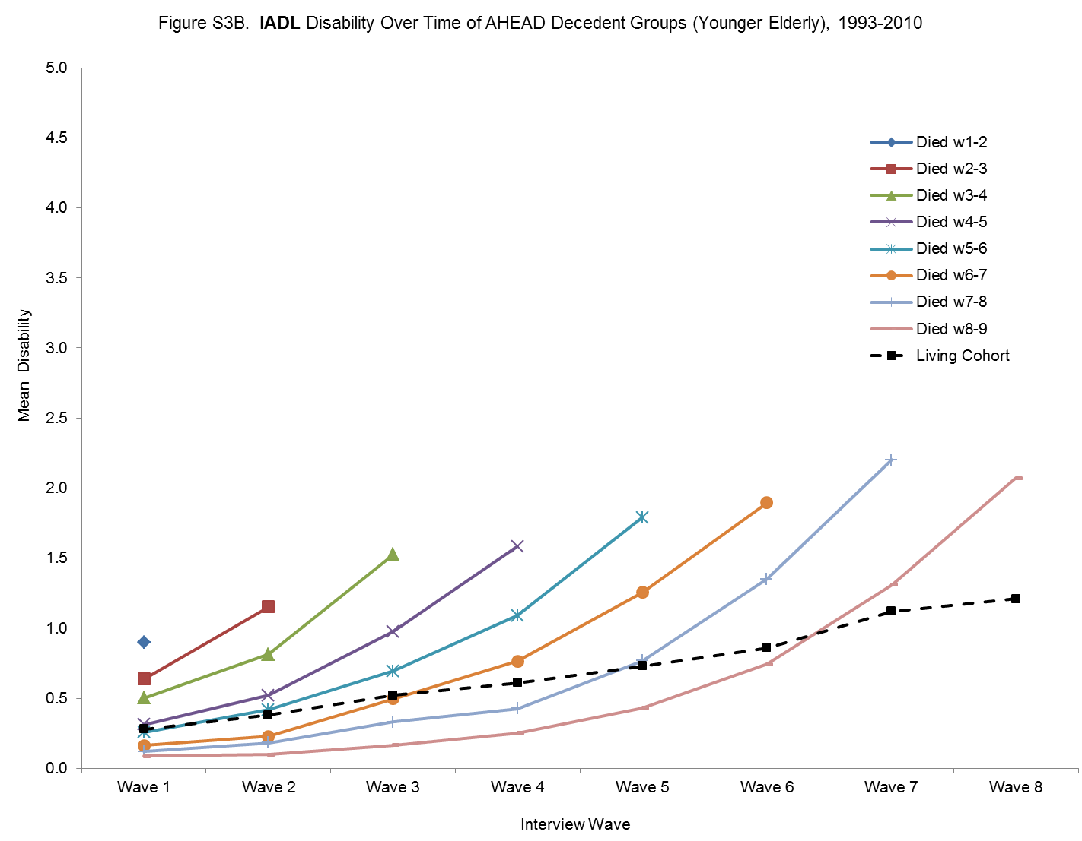

Slide 48
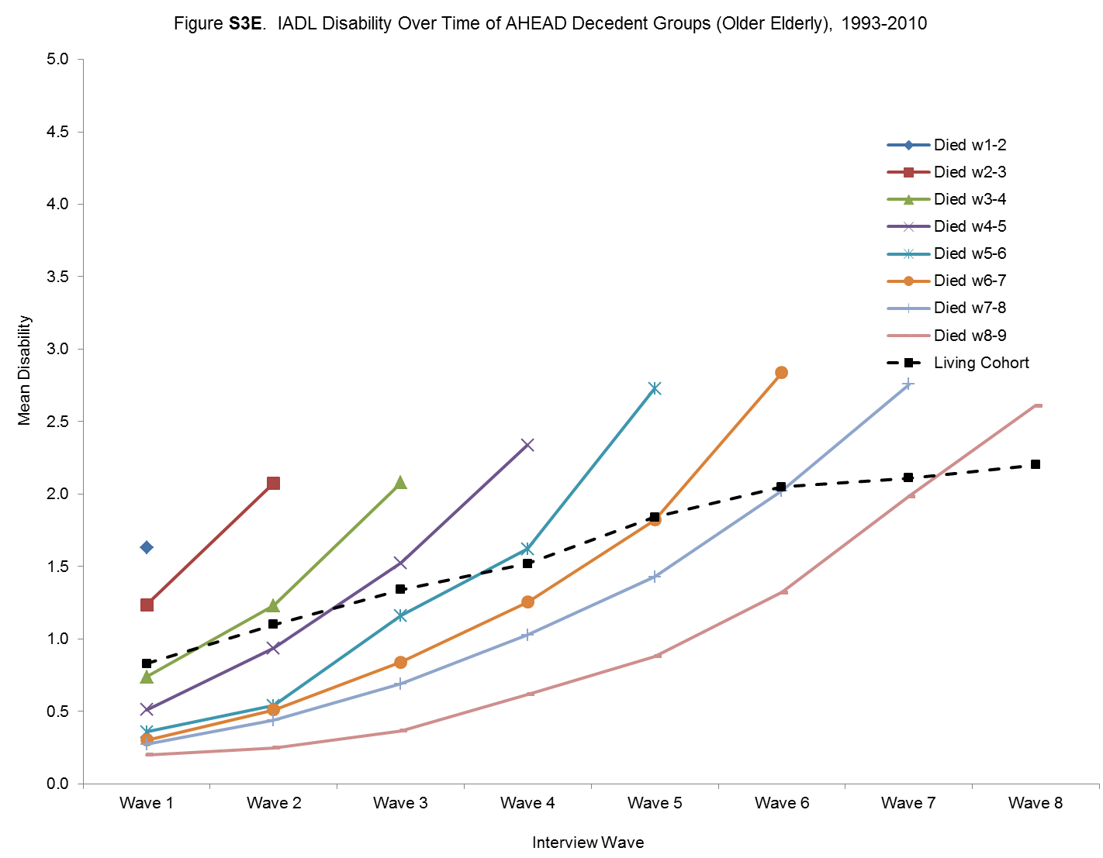

Slide 49
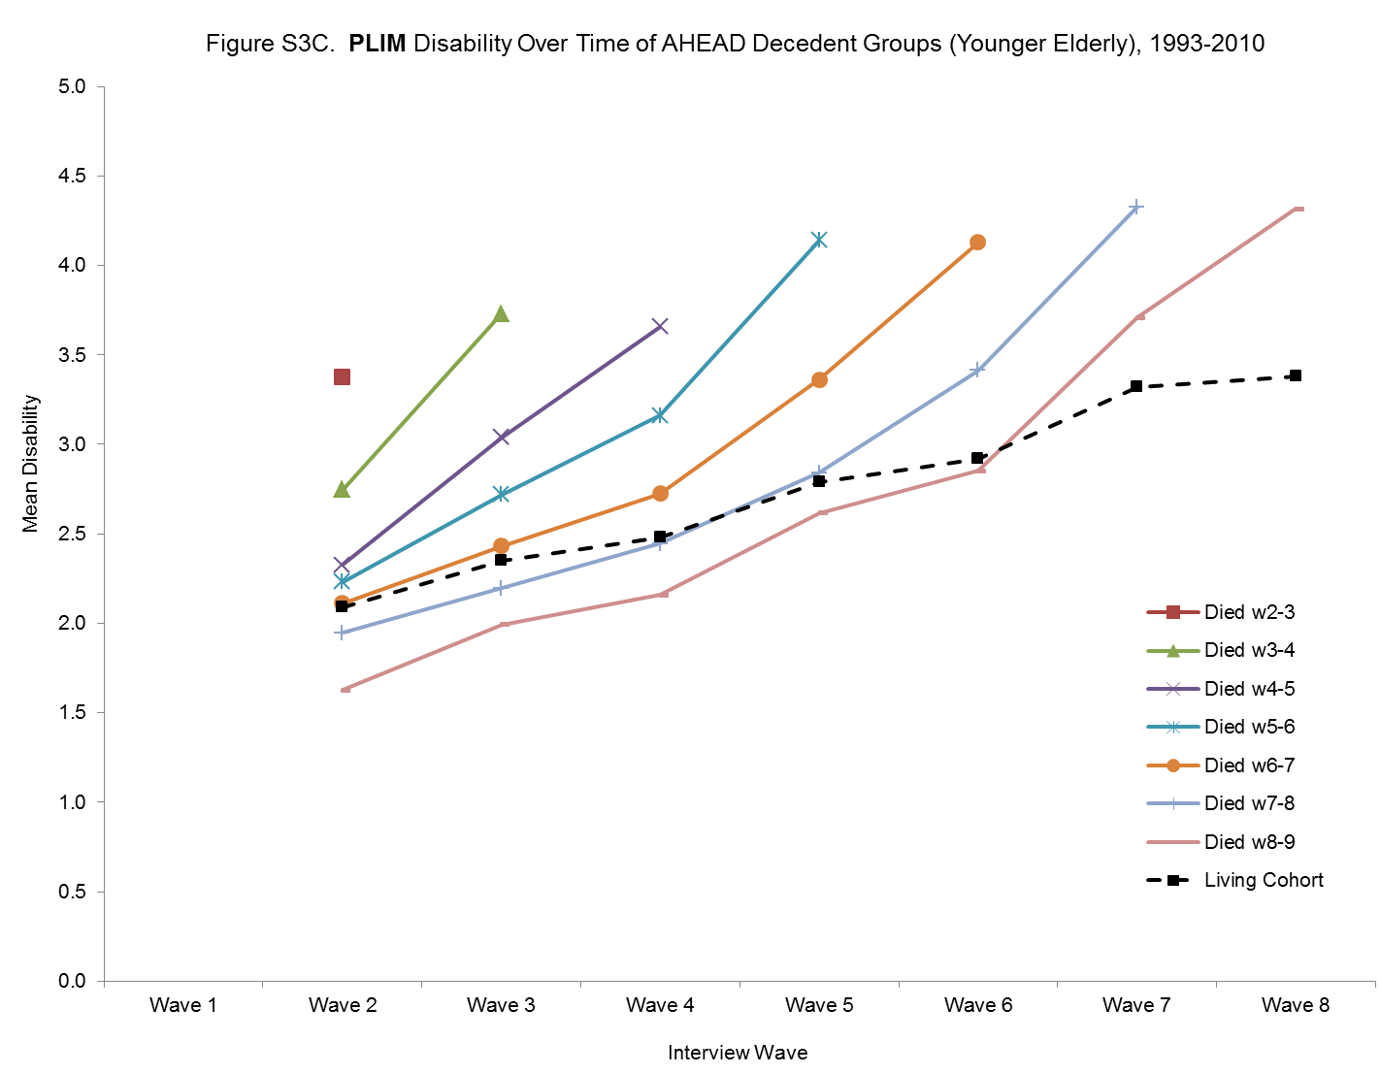

Slide 50
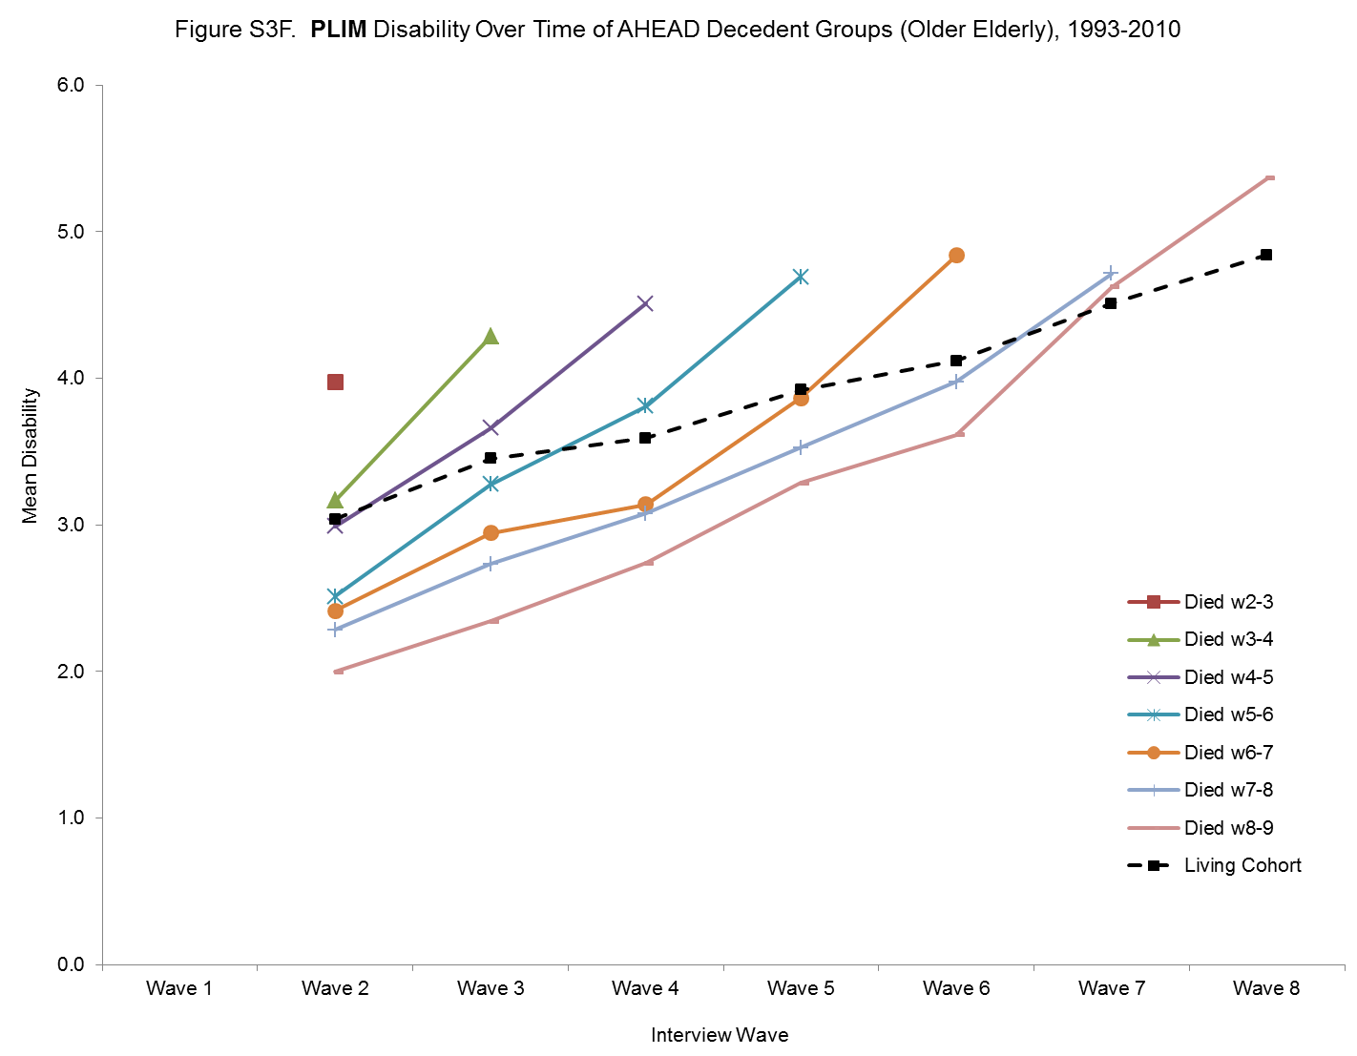

Slide 51
Survivor Groups

Slide 52
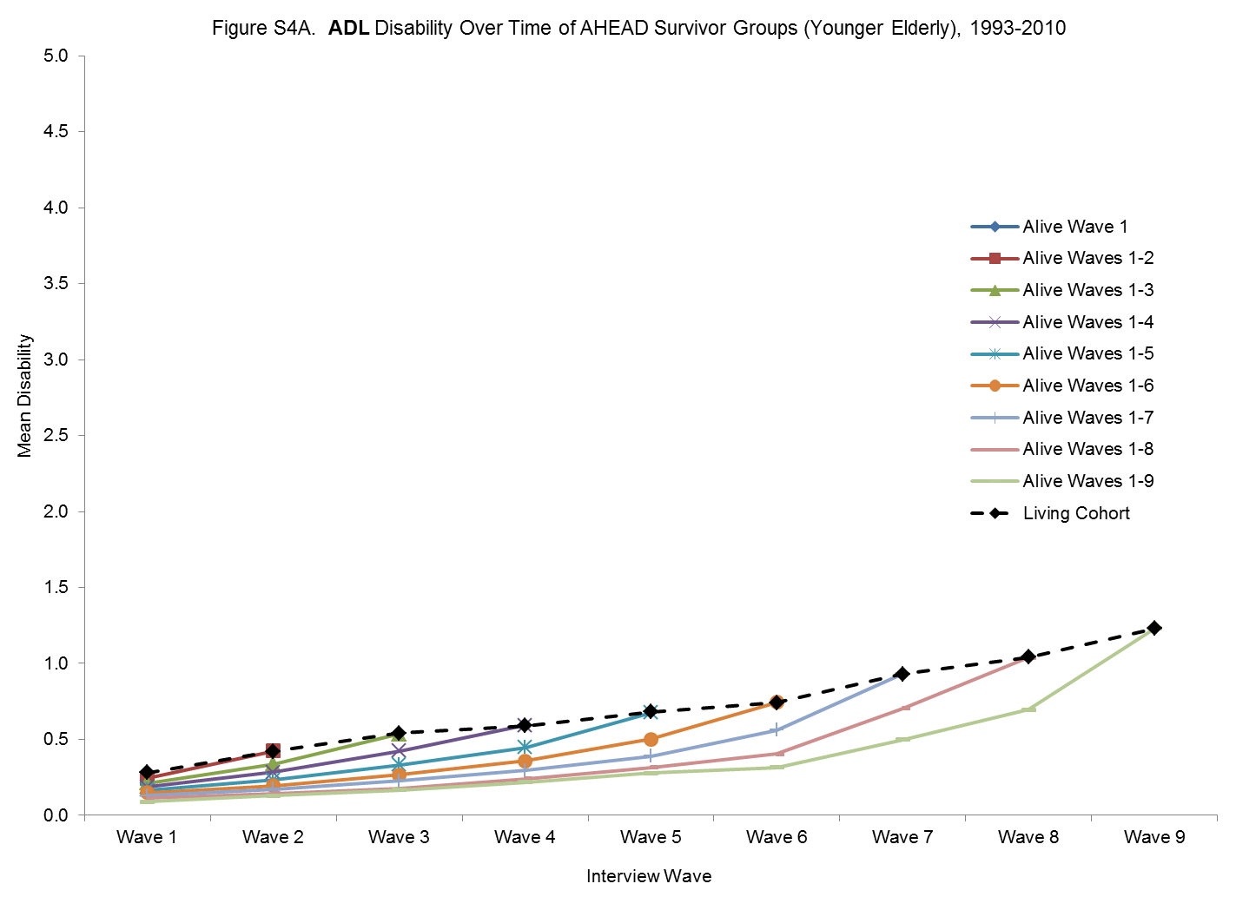

Slide 53
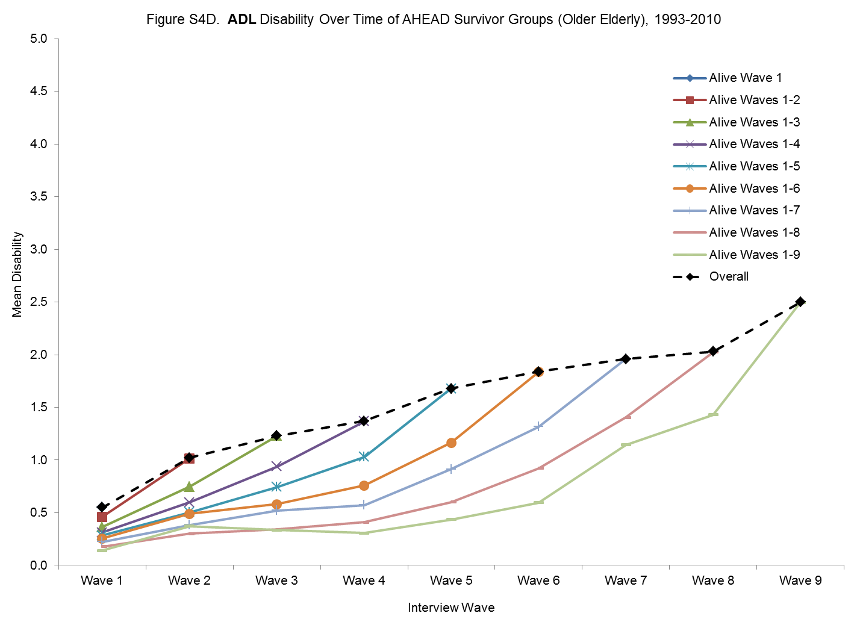

Slide 54
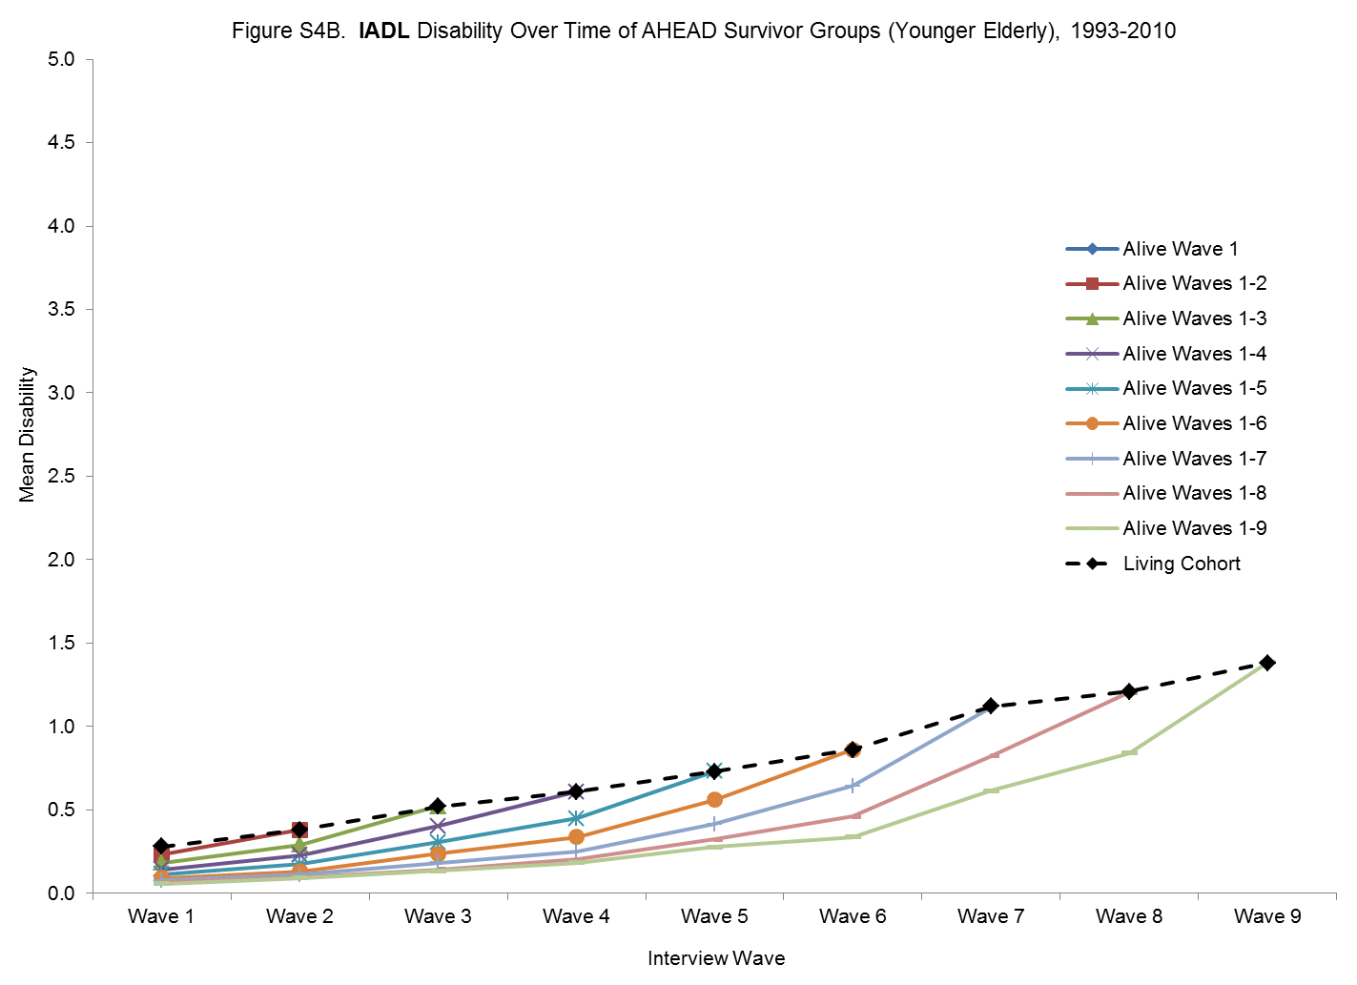

Slide 55
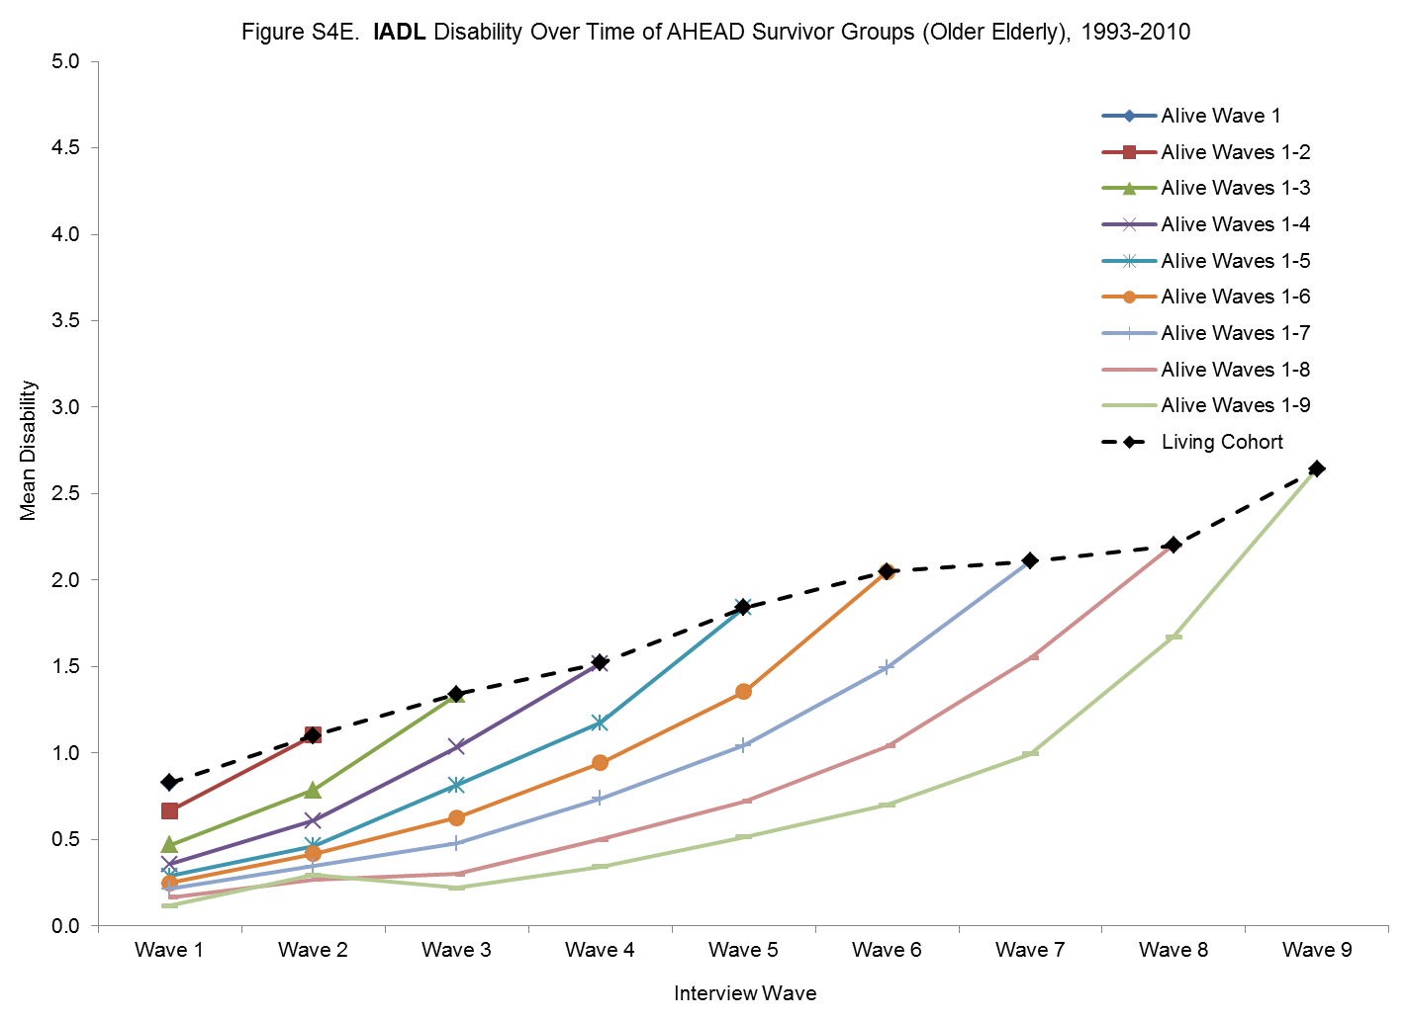

Slide 56
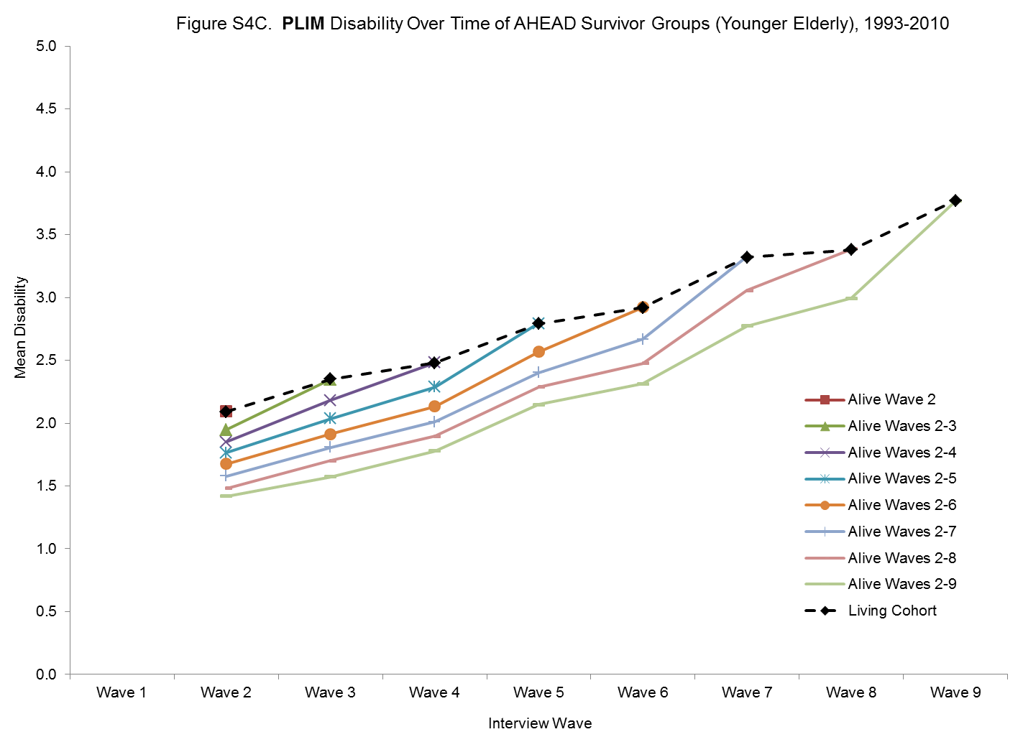

Slide 57
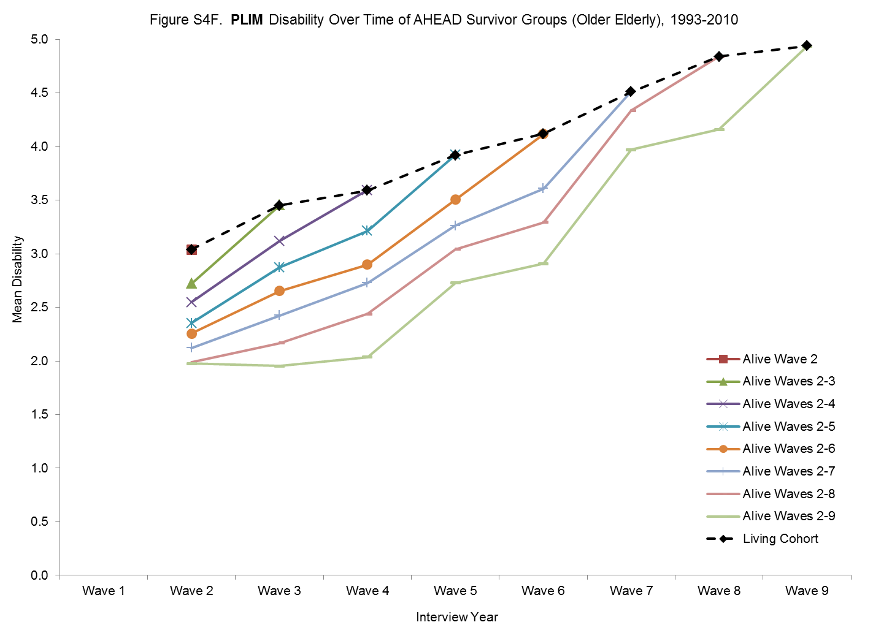

Slide 58
Compare Different Specifications of Time

Slide 59
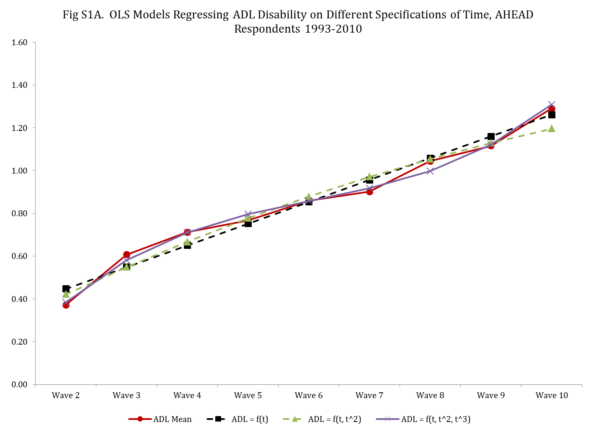

Slide 60
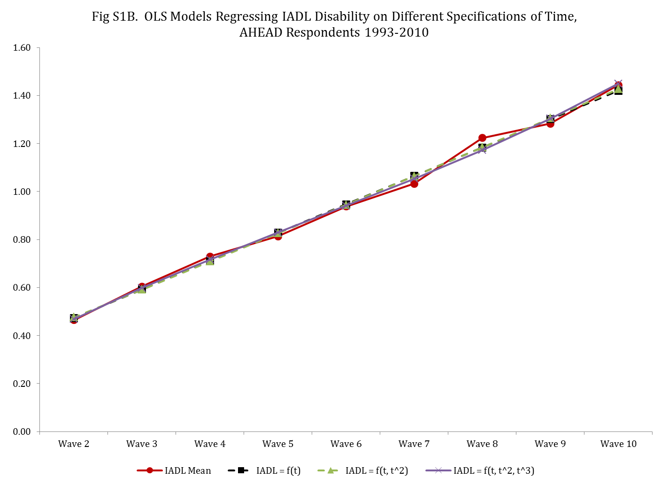

Slide 61
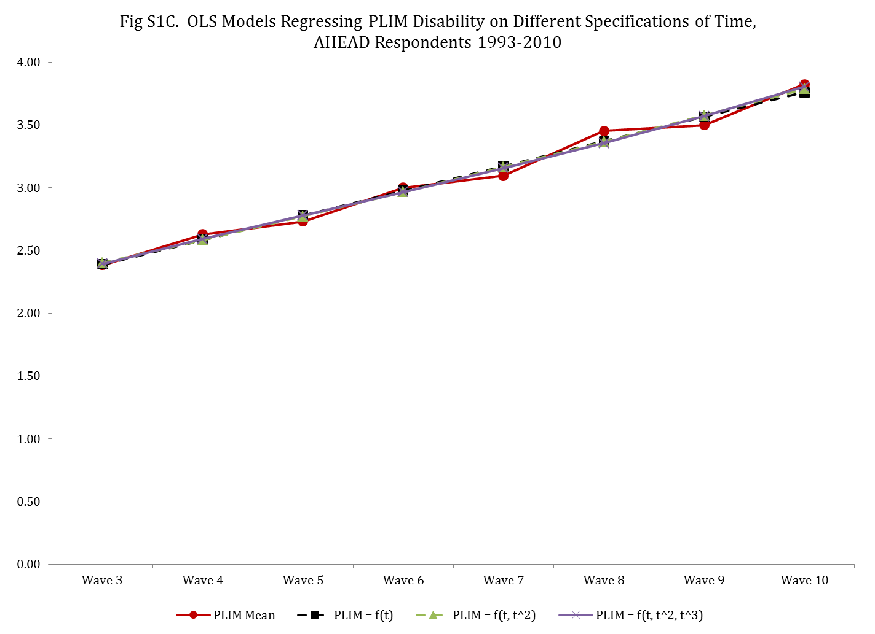

Slide 62
Compare Different Weighting Approaches

Slide 63
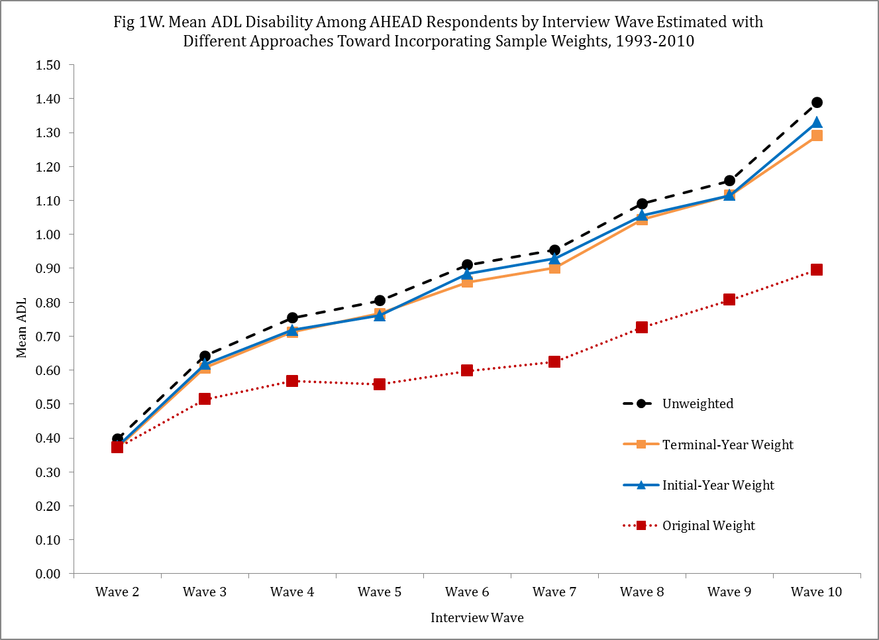

Slide 64
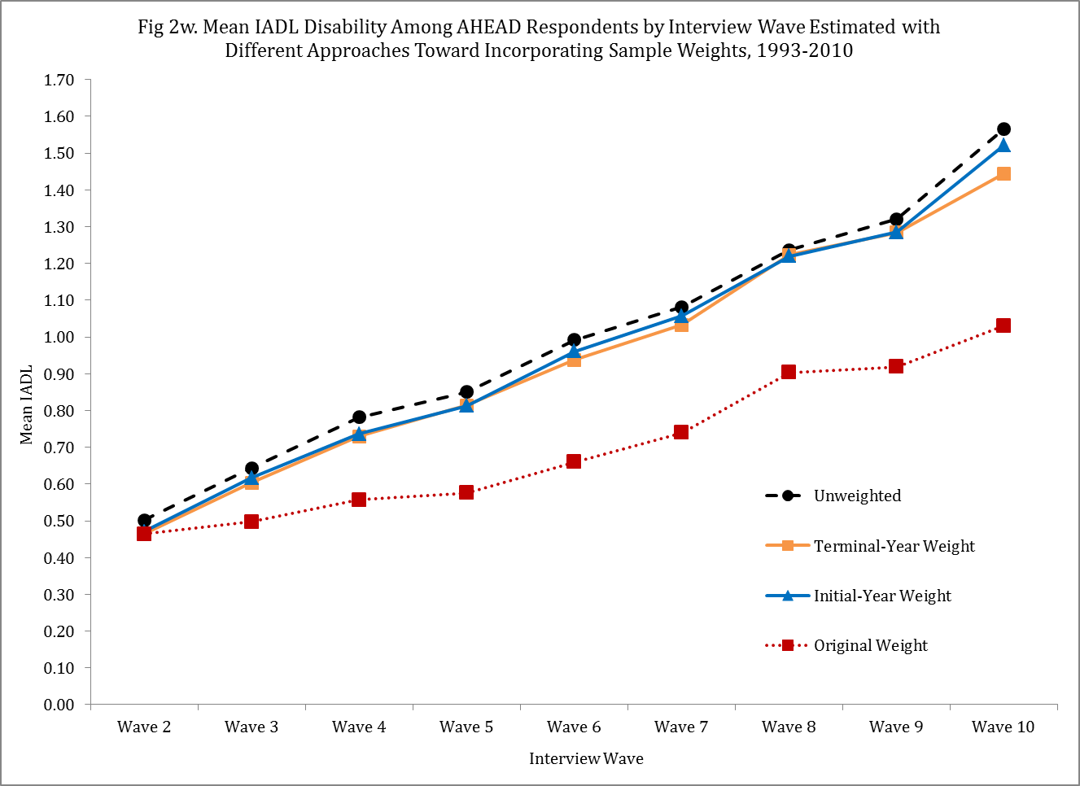

Slide 65
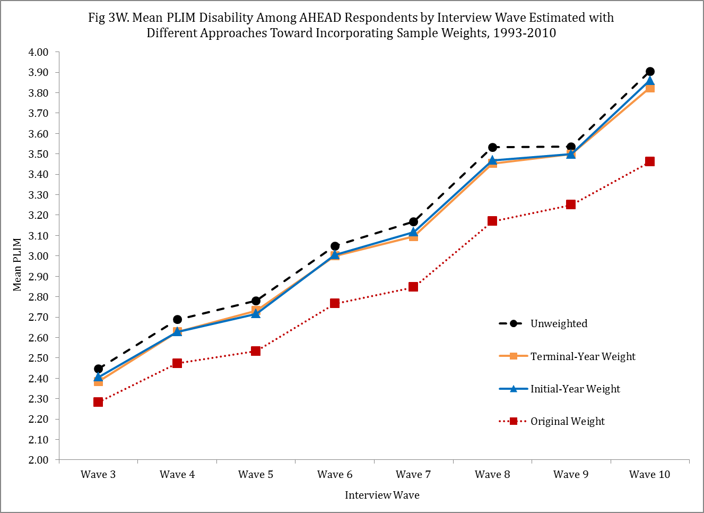

Slide 66
Results: Total Sample

Slide 67
  As a cohort ages and the most ill/frail persons exit by death, disability rises very little for living cohort members.

