Slide 1
Duke-NUS Graduate Medical School, Centre for Ageing Research and education
Live, Learn and Work – Exploring Possibilities with Longevity
A Symposium to Define the Framework for Transforming Singapore’s Rapid Ageing into a Demographic Powerhouse
12 November 2015, Auditorium Shaw Foundation Alumni House, 11 Kent Ridge Drive, Singapore 119244
“Singapore Longitudinal Ageing Studies of
Frailty and Resilience in Older Singaporeans: Implications for Policy and Practice” (10 minutes)
Tze- pin NG (MD)
Gerontology Research Programme, Department of Psychologcial Medicine, Yong Loo Lin School Of Medicine, National University Of Singapore

Slide 2
Introduction
Population ageing is associated with increasing societal burden of care for chronic diseases and disability in the elderly
A strategy for transforming increased life expectancy into healthy longevity
Prevent as many elderly people from becoming frail as possible
Help as many elderly to age healthily and successfully as possible.

Slide 3
Main Points
Understanding vulnerability and resilience in late life
Measuring frailty and healthy ageing
Risk, protective and moderating factors
Implications for policy and practice

Slide 4
Understanding vulnerability and resilience in late life
Phenotypic Manifestation
Frailty
Healthy Ageing
Underlying Phenomenon
Vulnerability
Resilience

Slide 5
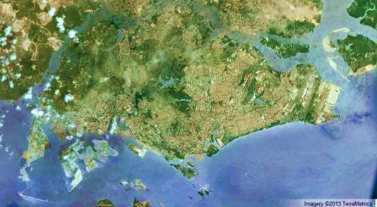
Singapore Longitudinal Ageing Studies
(2004 – 2014)
Community-living older adults age 55+
SLAS-1: N=2808
South East Region
Baseline: 2003-4
Follow ups: 2007-2008; 2010-2011
Mortality follow-up till 2010: mean 6 years
SLAS-2: N=3,200
South Central Region
South West Region
Baseline: 2009-2010
Follow-up: 2012-ongoing

Slide 6
Domains | Baseline Measurements
Psychosocial | Biodata, social network & support, work and retirement
Lifestyle and behavior | Lifestyle and behaviour: smoking, alcohol, coffee, tea, curry, mobile phone, computer use, Leisure-time activities,
Medical, biological, physiological | Medical history, medications, adherence, supplements, health service use (doctor visits, hospitalization)
 | BP, ECG, COPD Questionnaire, BORG dyspnea scale, Spirometry (pre- and post-bronchodilator), Logmar, Retinal Photography
 | Blood: fasting glucose, lipids, homocysteine, haematological, eGFR, albumin, hsCRP, TNF-a, IL-6
Diet and nutrition | Nutrition screening (modified NSI), food frequency intake, 24-hour food record, serum Hb, albumin, homocysteine, folate, B12,
Physical function | Instrumental and basic ADL, Handgrip, knee extension strength, POMA-Balance, POMA-Gait, Repeated Chair Rise, TUG, Fast Gait Speed Test; Total Energy Expenditure, LASA Physical Activity Questionnaire
Health status | Quality of Life (SF-12, EQ5D), 4-item Life Satisfaction scale, Successful ageing
Psychological | Geriatric Depression Scale (15 items), SCID diagnoses of psychiatric disorders; Sleep problems Resilience, optimism, ageing perceptions, mortality salience
Neurocognitive | Subjective Memory and Cognitive Complaint, IQCODE, Mini Mental State Examination (MMSE), NPI, MOCA, RBANS, Comprehensive Neurocognitive Test Battery: RAVLT, VR, Digit Span, CRT, SDMT, CTT, BD, BNT, story recall), Clinical Dementia Rating (CDR), Hatchinski, panel consensus diagnosis of dementia
Biobank | Genetic, inflammatory and immune and other ad hoc studies
xxxxxxxx
Follow Up
Cognition
Dementia
Depression
Physical functioning
Frailty
IADL
BADL
Quality of life,
Health service use
Mortality

Slide 7
Frailty in health and social service settings
Commonly recognized among geriatric patients and community-living older persons
In the past, poorly understood and under-studied
“I know it when I see it, but I can’t measure it.”
Recent research advances:
  Conceptualization and operational definition
  Measurements for screening, diagnosis and assessment
  Understanding and identification of risk and protective factors
  Frailty is reversible
  Treatment and prevention is possible

Slide 8
Defining Frailty
A biologic syndrome associated with multisystem declines and diminished physiologic reserve
Increased vulnerability to stressors
Increased risk of adverse outcomes such as disability, hospitalization and deaths.
Causally related to but distinct from comorbidity and disability
(A consensus group of the American Geriatrics Society Ferrucci L, Guralnik JM, Studenski S et al. Interventions on Frailty Working Group. J Am Geriatr Soc 2004; 52: 625–34.)

Slide 9
Measuring Physical Frailty
Cardiovascular Health Study (CHS) criteria
Unintentional shrinking: BMI of <18.5 kg/m2 and/or unintentional weight loss ≥10 pounds (4.5Kg) in the last 6 months.
Slowness: 6-meter fast gait speed test, lowest quintile by gender and height
Weakness: leg muscle strength in kilograms, lowest quintile by gender and BMI strata
Exhaustion: vitality questions in SF-12: “Did you feel worn out?”, “Did you feel tired?”, “Did you have a lot of energy?”, (total scores 3 to 15), score of <10
Low activity: self-reported time (in hours) spent doing moderate and vigorous activities per week, lowest quintile by gender
Categories:
Robust: No components
Pre-frail: 1 to 2 components
Frail: 3 -5 components

Slide 10
Physical Frailty is associated with concomitant Multi-morbidity and Adverse Outcomes
Adverse Outcomes |  | Robust n=883 |  | Pre-frail N=712 |  | Frail N=90 |  | P
Depressive symptoms | % | 0.8 |  | 2.8 |  | 10.0 |  | <0.001
Cognitive impairment | % | 4.1 |  | 8.4 |  | 22.2 |  | <0.001
Multi-morbidity (>5 ) | % | 17.8 |  | 27.4 |  | 52.2 |  | <0.001
IADL disability | % | 5.0 |  | 11.0 |  | 26.7 |  | <0.001
ADL Disability | % | 0.2 |  | 3.2 |  | 7.8 |  | <0.001
Hospital admission | % | 4.5 |  | 5.9 |  | 10.0 |  | 0.033
SLAS Data: J Am Med Dir Assoc.2014 Sep;15(9):635-42.

Slide 11
Physical Frailty predicts Incident Adverse Health Outcomes
SLAS Data: Manuscript in preparation

Slide 12
Physical Frailty Social Profile
Socio-economic Factors |  |  | Robust n=883 |  | Pre-frail N=712 |  | Frail N=90 |  | P value
Age 75+ | % |  | 7.9 |  | 20.2 |  | 36.7 |  | <0.001
Female | % |  | 64.1 |  | 64.2 |  | 67.8 |  | 0.66
No formal education | % |  | 15.1 |  | 26.1 |  | 34.4 |  | <0.001
1-2 room public housing | % |  | 16.7 |  | 25.6 |  | 41.1 |  | <0.001
Non-Chinese ethnicity | % |  | 9.0 |  | 12.6 |  | 14.4 |  | 0.010
Single, divorced, widowed | % |  | 29.0 |  | 39.3 |  | 52.2 |  | <0.001
Living alone | % |  | 12.9 |  | 18.7 |  | 26.7 |  | <0.001
Current smoking | % |  | 19.7 |  | 25.5 |  | 27.3 |  | 0.004
Daily alcohol drinking | % |  | 3.4 |  | 2.4 |  | 1.1 |  | 0.114

Slide 13
Physical Frailty Clinical Profile
Chronic diseases |  |  | Robust n=883 |  | Pre-frail N=712 |  | Frail N=90 |  | P value
Cardiovascular disease | % |  | 5.7 |  | 10.5 |  | 15.6 |  | <0.001
Hypertension | % |  | 58.1 |  | 63.8 |  | 80.0 |  | <0.001
Diabetes | % |  | 17.1 |  | 23.9 |  | 31.1 |  | <0.001
Stroke | % |  | 1.6 |  | 4.1 |  | 12.2 |  | <0.001
Coronary heart disease | % |  | 3.2 |  | 4.5 |  | 7.8 |  | 0.028
Atrial Fibrillation | % |  | 2.2 |  | 4.4 |  | 4.4 |  | 0.016
Heart failure | % |  | 0.7 |  | 2.3 |  | 3.3 |  | 0.003
Cataracts/ glaucoma | % |  | 26.3 |  | 32.9 |  | 51.1 |  | <0.001
Asthma/COPD | % |  | 3.2 |  | 6.2 |  | 11.1 |  | <0.001
Arthritis | % |  | 13.5 |  | 15.7 |  | 20.0 |  | 0.063
Osteoporosis | % |  | 4.6 |  | 6.7 |  | 12.2 |  | 0.003
Gastrointestinal problems | % |  | 5.9 |  | 7.9 |  | 15.6 |  | 0.002
Chronic Kidney disease | % |  | 4.5 |  | 10.8 |  | 18.9 |  | <0.001
Cancer | % |  | 2.6 |  | 2.3 |  | 6.7 |  | 0.29
Thyroid disease | % |  | 4.6 |  | 5.8 |  | 1.1 |  | 0.86

Slide 14
Physical Frailty Clinical Profile
Clinical Factors |  | Robust n=883 |  | Pre-frail N=712 |  | Frail N=90 |  | P
Poly-pharmacy (>5 drugs) | % | 10.0 |  | 20.1 |  | 28.9 |  | <0.001
Poor self-rated health | % | 0.3 |  | 1.3 |  | 6.7 |  | <0.001
Visual impairment | % | 20.7 |  | 31.7 |  | 45.6 |  | <0.001
Hearing impairment | % | 1.7 |  | 4.1 |  | 3.3 |  | 0.012
FEV1/FVC <0.7 | % | 15.5 |  | 21.8 |  | 31.1 |  | <0.001

Slide 15
Physical Frailty Nutritional Profile
Nutritional Status Factors |  | Robust n=883 |  | Pre-frail N=712 |  | Frail N=90 |  | P
Obesity (BMI ≥ 30) |  | 5.1 |  | 7.4 |  | 13.3 |  | 0.002
High nutritional risk (NNS score≥3) |  | 21.9 |  | 37.5 |  | 53.3 |  | <0.001
Low albumin (<40 g/L) |  | 8.8 |  | 13.2 |  | 18.9 |  | <0.001
Low haemoglobin |  | 34.9 |  | 41.0 |  | 47.8 |  | 0.002
Low total cholesterol 0~5.19mmol/L) |  | 47.0 |  | 52.3 |  | 55.1 |  | 0.022

Slide 16
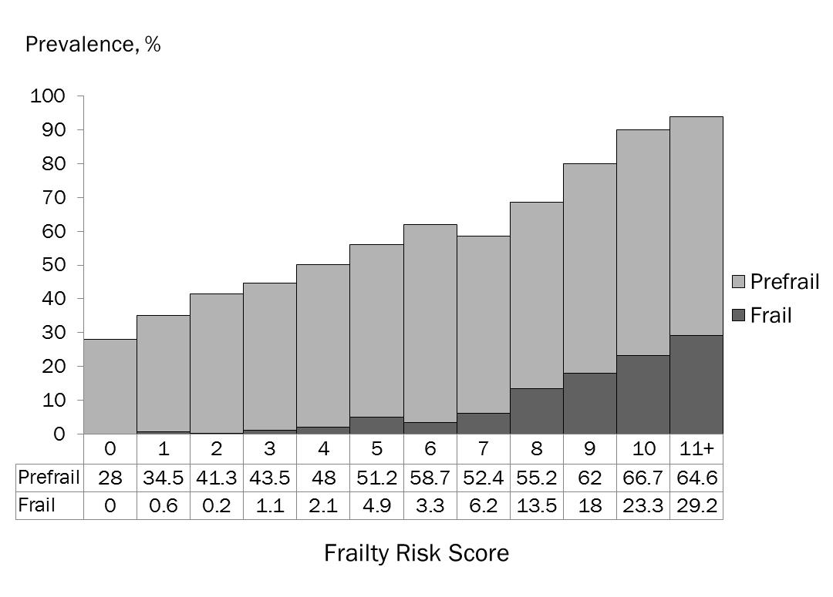
Clinical Risk Factors Screening Tool
Ng TP, et al; J Am Med Dir Assoc.2014 Sep;15(9):635-42.

Slide 17
Frailty Is Reversible
Nutritional, Physical And Cognitive Training Interventions Effectively Reduce Frailty

Slide 18
Frailty Is Reversible
Singapore Frailty Intervention Trial (FIT)

Slide 19
Frailty is reversible
SLAS Frailty Intervention Trial (Manuscript in preparation)

Slide 20
Frailty is reversible
SLAS Frailty Intervention Trial (Manuscript in preparation)

Slide 21
Frailty is reversible
SLAS Frailty Intervention Trial (Manuscript in preparation)

Slide 22
Frailty is reversible
SLAS Frailty Intervention Trial (Manuscript in preparation)

Slide 23
Frailty is reversible
SLAS Frailty Intervention Trial (Manuscript in preparation)

Slide 24
Frailty is reversible
SLAS Frailty Intervention Trial (Manuscript in preparation)

Slide 25
Frailty is reversible
SLAS Frailty Intervention Trial (Manuscript in preparation)

Slide 26
Frailty is reversible
SLAS Frailty Intervention Trial (Manuscript in preparation)

Slide 27
Frailty is reversible
SLAS Frailty Intervention Trial (Manuscript in preparation)

Slide 28
Frailty is reversible
SLAS Frailty Intervention Trial (Manuscript in preparation)

Slide 29
Resilience in Old Age
Resilience in Old Age
Positive adaptation despite adversities
Chronic diseases and illness and pain
Limitations in Body Functions
Work- Retirement Transition Stress
Loss and Bereavement
High Function and Wellbeing
Good Quality of Life
Successful Ageing
Positive adaptation despite adversities
Good Coping
Poor Coping
Depression/ Dementia
Disability: Restricted Life Activities
Poor Quality of Life

Slide 30
Connor-Davidson Resilience Scale: SLAS-1 Factor Structure
 |  | Factor
No. | Item Description | Sense of personal competence & optimism | Commitment and perseverance | Independence and self-esteem
1 | Able to adapt to change | .691
7 | Coping with stress strengthens | .647
6 | See the humorous side of things | .646
4 | Can deal with whatever comes | .629
5 | Past success gives confidence for new challenge | .582
8 | Tend to bounce back after illness or hardship | .550
9 | Things happen for a reason | .509
22 | In control of life | .505
11 | Can achieve goals | .441
2 | Close and secure relationships | .415
14 | Under pressure, focus and think clearly |  | .663
17 | Think of self as strong person |  | .643
10 | Best effort no matter what | .433 | .613
12 | When things look hopeless, don't give up |  | .602
13 | Know where to turn for help |  | .544
19 | Can handle unpleasant feelings | .328 | .512
16 | Not easily discouraged by failure |  | .511
15 | Prefer to take the lead in problem solving |  |  | .720
21 | Strong sense of purpose |  |  | .708
23 | Like challenges | .313 |  | .698
24 | Work to attain goals | .356 | .321 | .489
3 | Sometimes fate or God can help |  | -.324 | .484
18 | Make unpopular or difficult decisions |  |  | .453
25 | Pride in achievements | .384 |  | .404
20 | Have to act on a hunch |  |  | .398
Note: factors with loadings <0.30 are not shown.

Slide 31
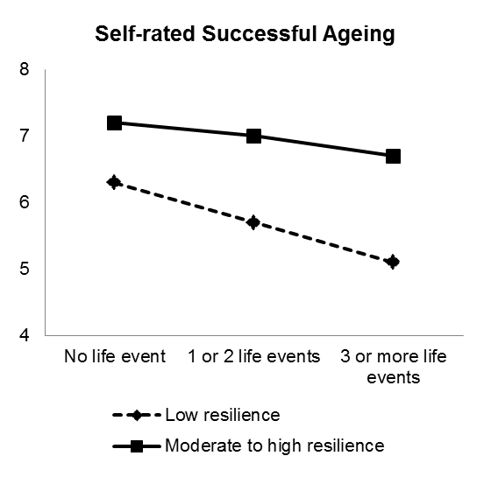
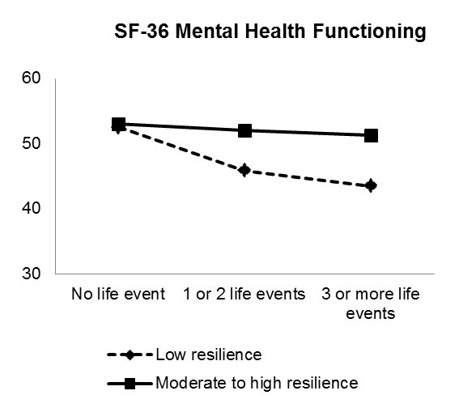
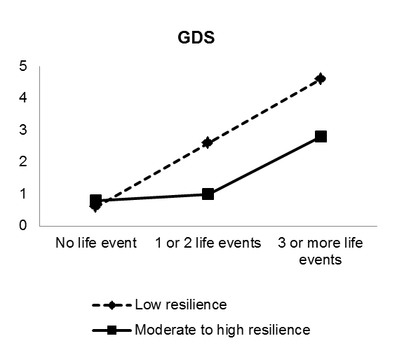
Resilience, Stressful Life Events and Subjective Well-Being
Manuscript in preparation

Slide 32

Successful Ageing (Criterion-based)
Am J Ger Psychiatry (2009)

Slide 33
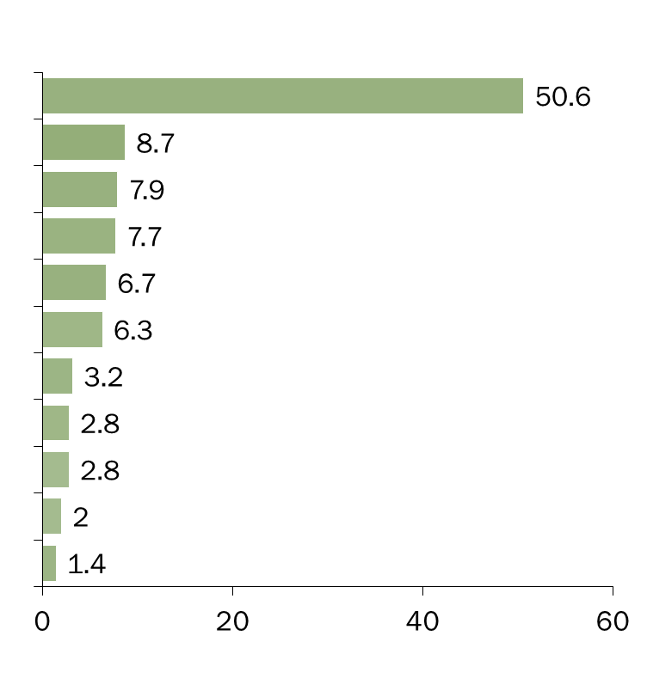
FACTORS FOR SUCCESSFUL AGEING: VIEWS AND VALUES
The most important factor for successful ageing for me is
%

Slide 34
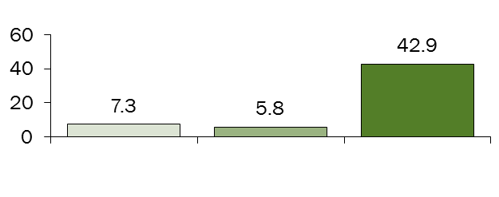
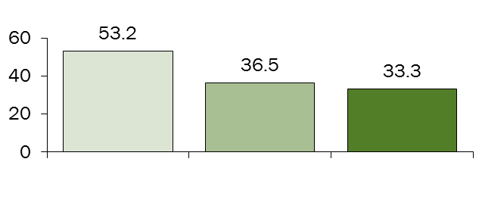
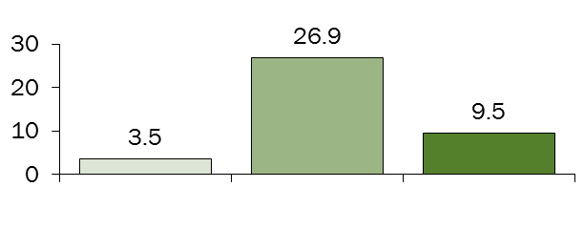
FACTORS FOR SUCCESSFUL AGEING:
Chinese Malay Indian
The most important factor for successful ageing for me is:
Percent
Physical Health
Financial Stability
Fulfilling marital / significant relationships

Slide 35
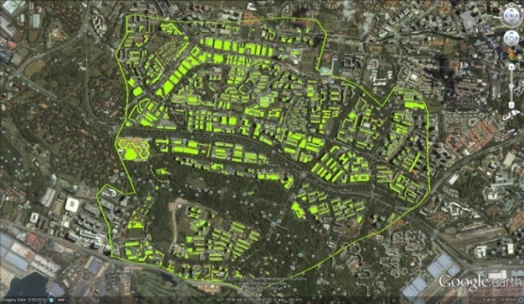
Neighbourhood Environment and Physical Activity
Base Model + Subjective + Objective Measures | Coefficient | 95% | CI | p
Resident density | 0.95 | 0.44 | 1.46 | <0.001
Street connectivity | 0.58 | -0.07 | 1.24 | 0.08
Land Use Mix-Access | -0.40 | -0.92 | 0.13 | 0.14
Land Use Mix-diversity | 0.72 | 0.18 | 1.26 | 0.009
Infra-structure (walking and cycling) | 0.28 | -0.17 | 0.73 | 0.22
Aesthetics | 0.16 | 0.11 | 0.21 | <0.001
Traffic safety | 0.06 | -0.27 | 0.39 | 0.72
Crime safety | -0.24 | -0.68 | 0.20 | 0.29
GIS Walkability | 0.28 | -1.61 | 2.17 | 0.77
GIS Accessibility | 1.59 | 0.02 | 3.15 | 0.05
Controlling for age, sex, education, race, number of chronic medical illnesses, self-rated health, GDS, POMA_B, POMA-G, and other BE measures
R²=0.43

Slide 36
Neighbourhood Environment and RBANS Cognitive Performance
BE Measures |  | RBANS Total z-score
Subjective measures |  | Coeff | SE | β | p
Residential density |  | -0.001 | 0.003 | -0.021 | 0.785
Connectivity |  | -0.003 | 0.003 | -0.071 | 0.236
Infrastructure |  | 0.000 | 0.002 | -0.008 | 0.874
Aesthetics |  | 0.004 | 0.002 | 0.085 | 0.082
Accessibility |  | 0.002 | 0.002 | 0.045 | 0.407
Land use mix diversity |  | 0.007 | 0.003 | 0.161 | 0.008
Traffic safety |  | 0.001 | 0.003 | 0.012 | 0.868
Crime safety |  | 0.000 | 0.003 | 0.008 | 0.898
Objective GIS measures
Walkability |  | 0.071 | 0.023 | 0.163 | 0.002
Accessibility |  | 0.014 | 0.024 | 0.032 | 0.572
Controlling for age, sex, education, race, number of chronic medical illnesses, self-rated health, GDS, POMA_B, POMA-G, and other BE measures

Slide 37

Possibilities for policy and practice
We can prevent more older people from becoming frail by screening, diagnosing, assessing and treating frailty in clinic and community settings
More people can age successfully by culturally-sensitive and environmentally-friendly social interventional policies and planning

Slide 38

Acknowledgement
Grant funding support
A*STAR Biomedical Research Council
 | BMRC grant 03/1/21/17/214
 | SIgN 10-036
Ministry of Health National Medical Research Council
 | NMRC/0846/2004
 | NMRC/1108/2007:
 | NMRC/08/1/21/19/567
Anonymous Donor
 | R-177-000-028-720.

Slide 39
Acknowledgement
Co-investigators, Collaborators, Research Fellows:
Keng Bee Yap, Philip Yap, Boon Yeow Tan, Chan Sue Mei, Khoo Sue Ann, Gribson Chan (KTPH, NTFH, SLH)
Ma Shwe Zin Nyunt, Gao Qi, Liang Feng, Feng Lei (NUS)
VWO Collaborators and Partners:
Geylang East Home for the Aged
Presbyterian Community Services
Thye Hua Kwan Moral Society (Moral Neighbourhood Links),
Yuhua Neighbourhood Link
Redhill Moral Seniors Activity Centre
Henderson Senior Citizens’ Home
NTUC Eldercare Co-op Ltd
Thong Kheng Seniors Activity Centre (Queenstown Centre)

Slide 40
Thank You

